Slide 1
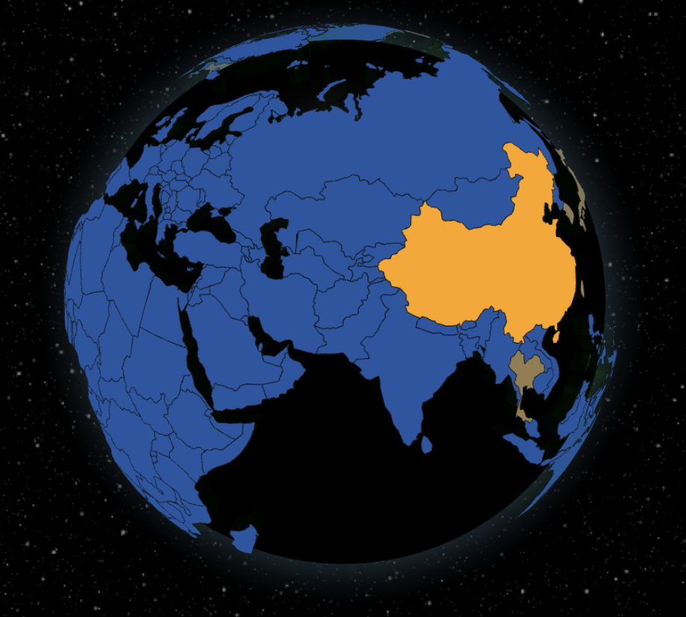
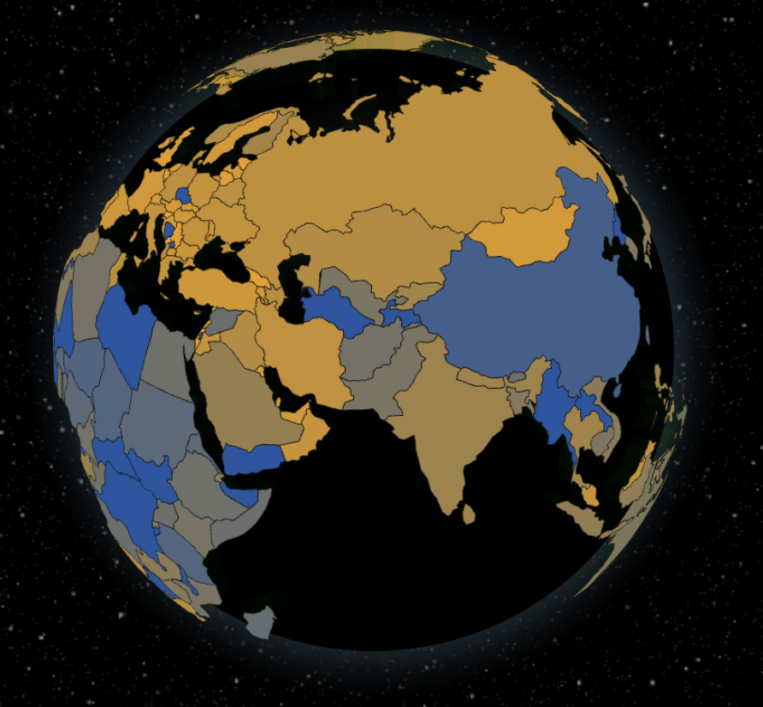
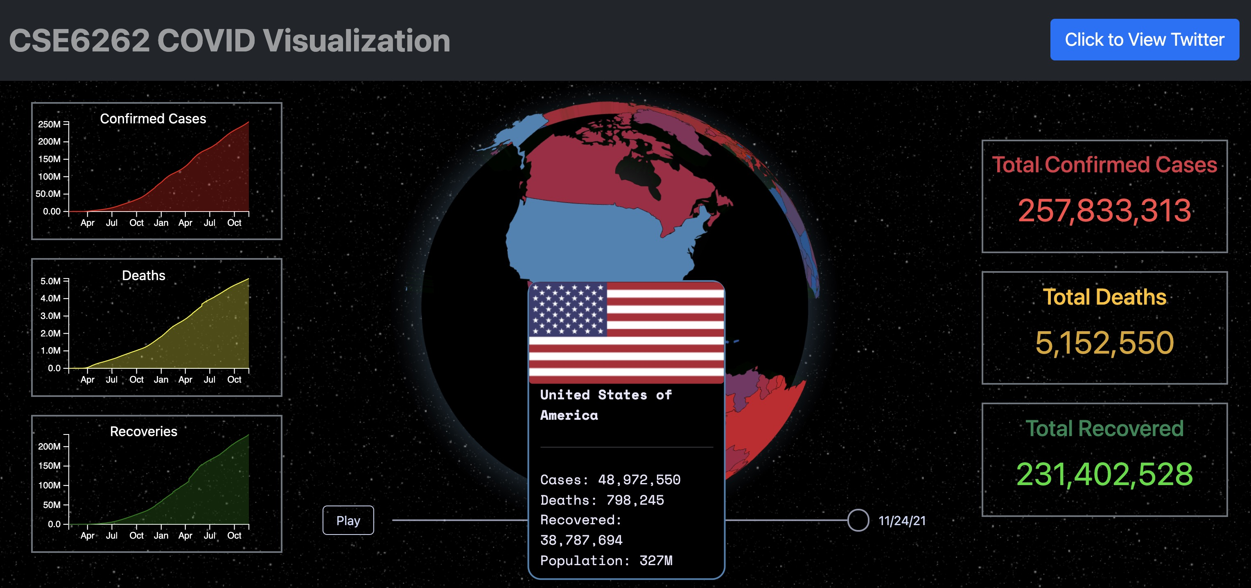
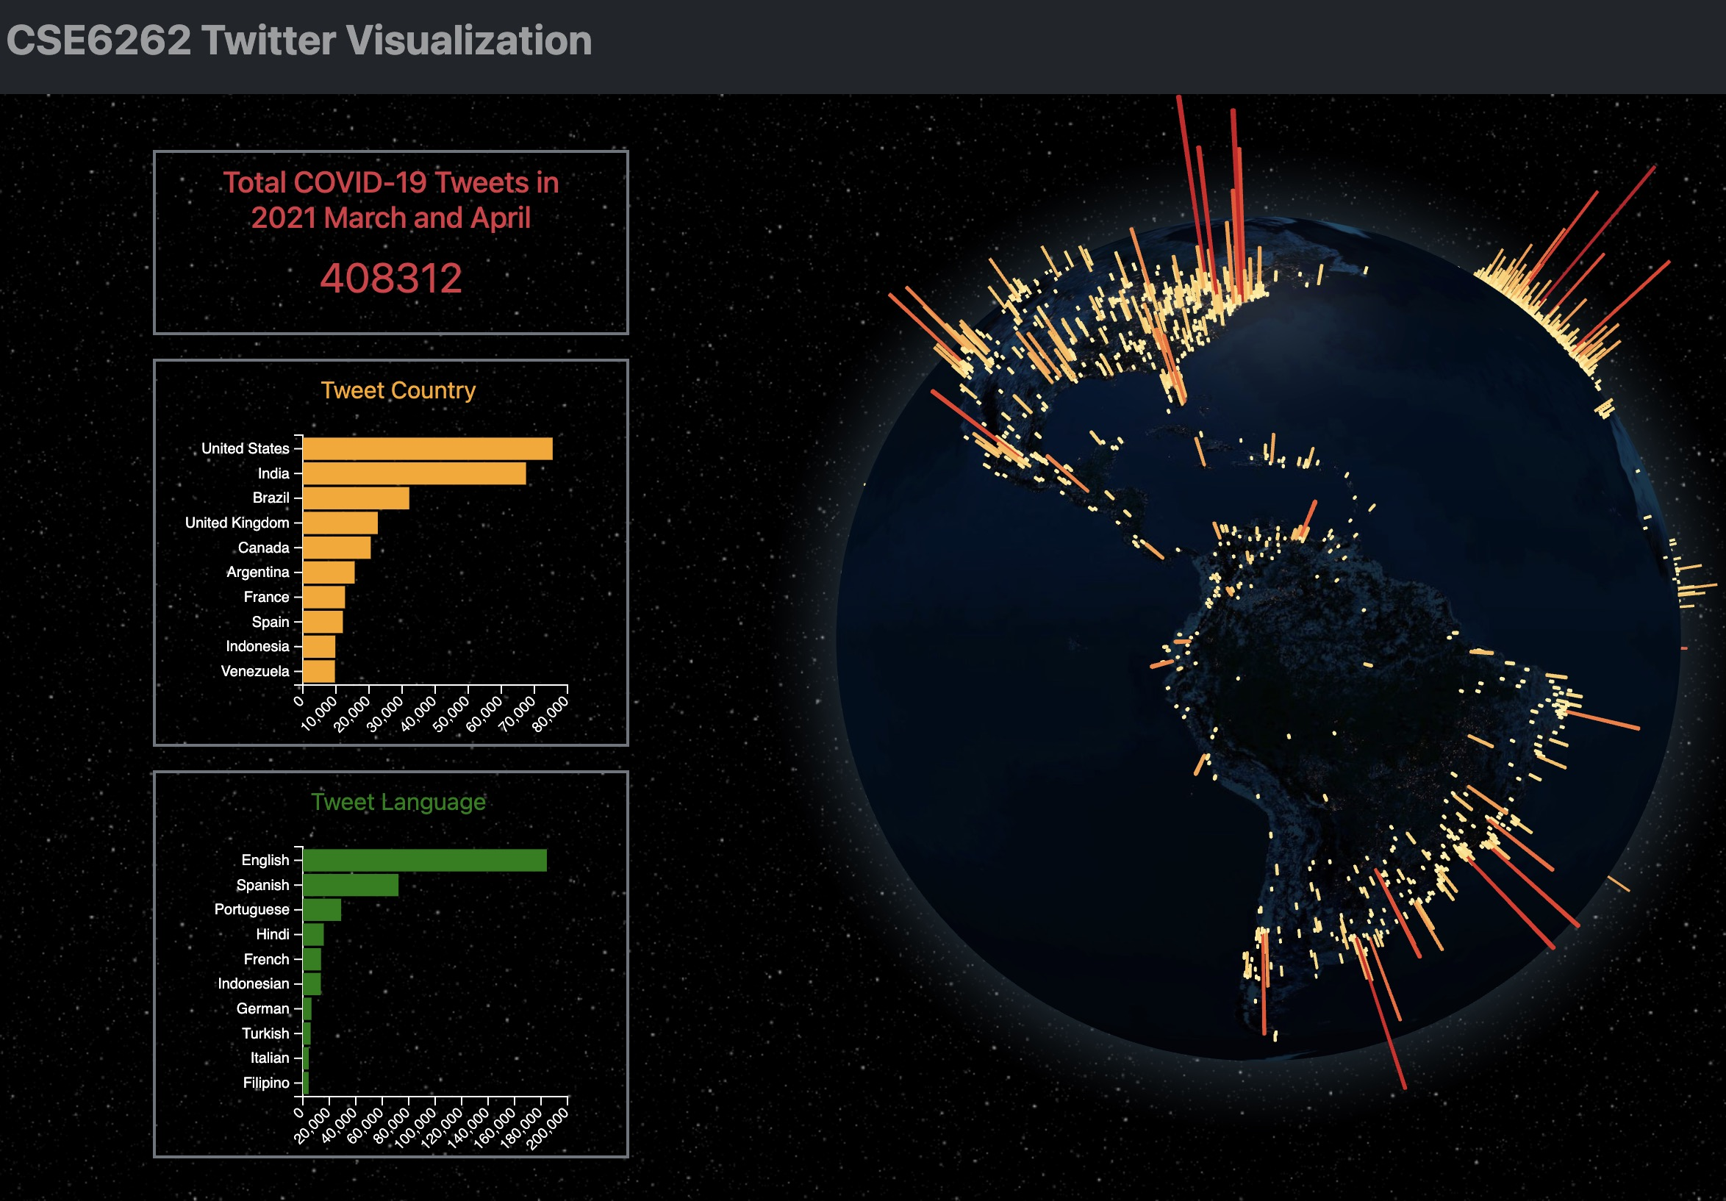

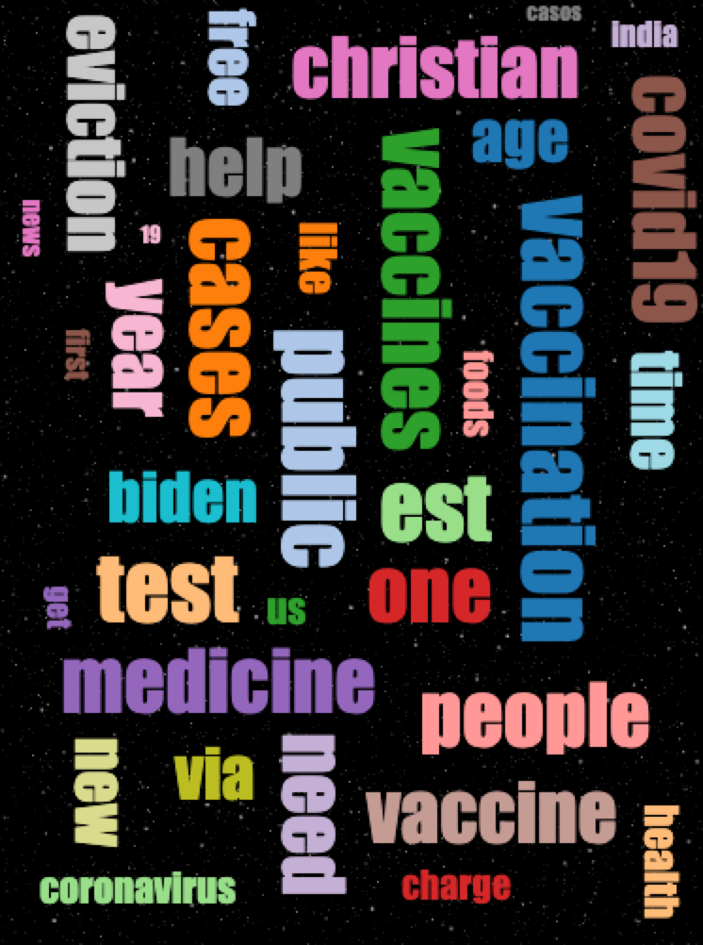
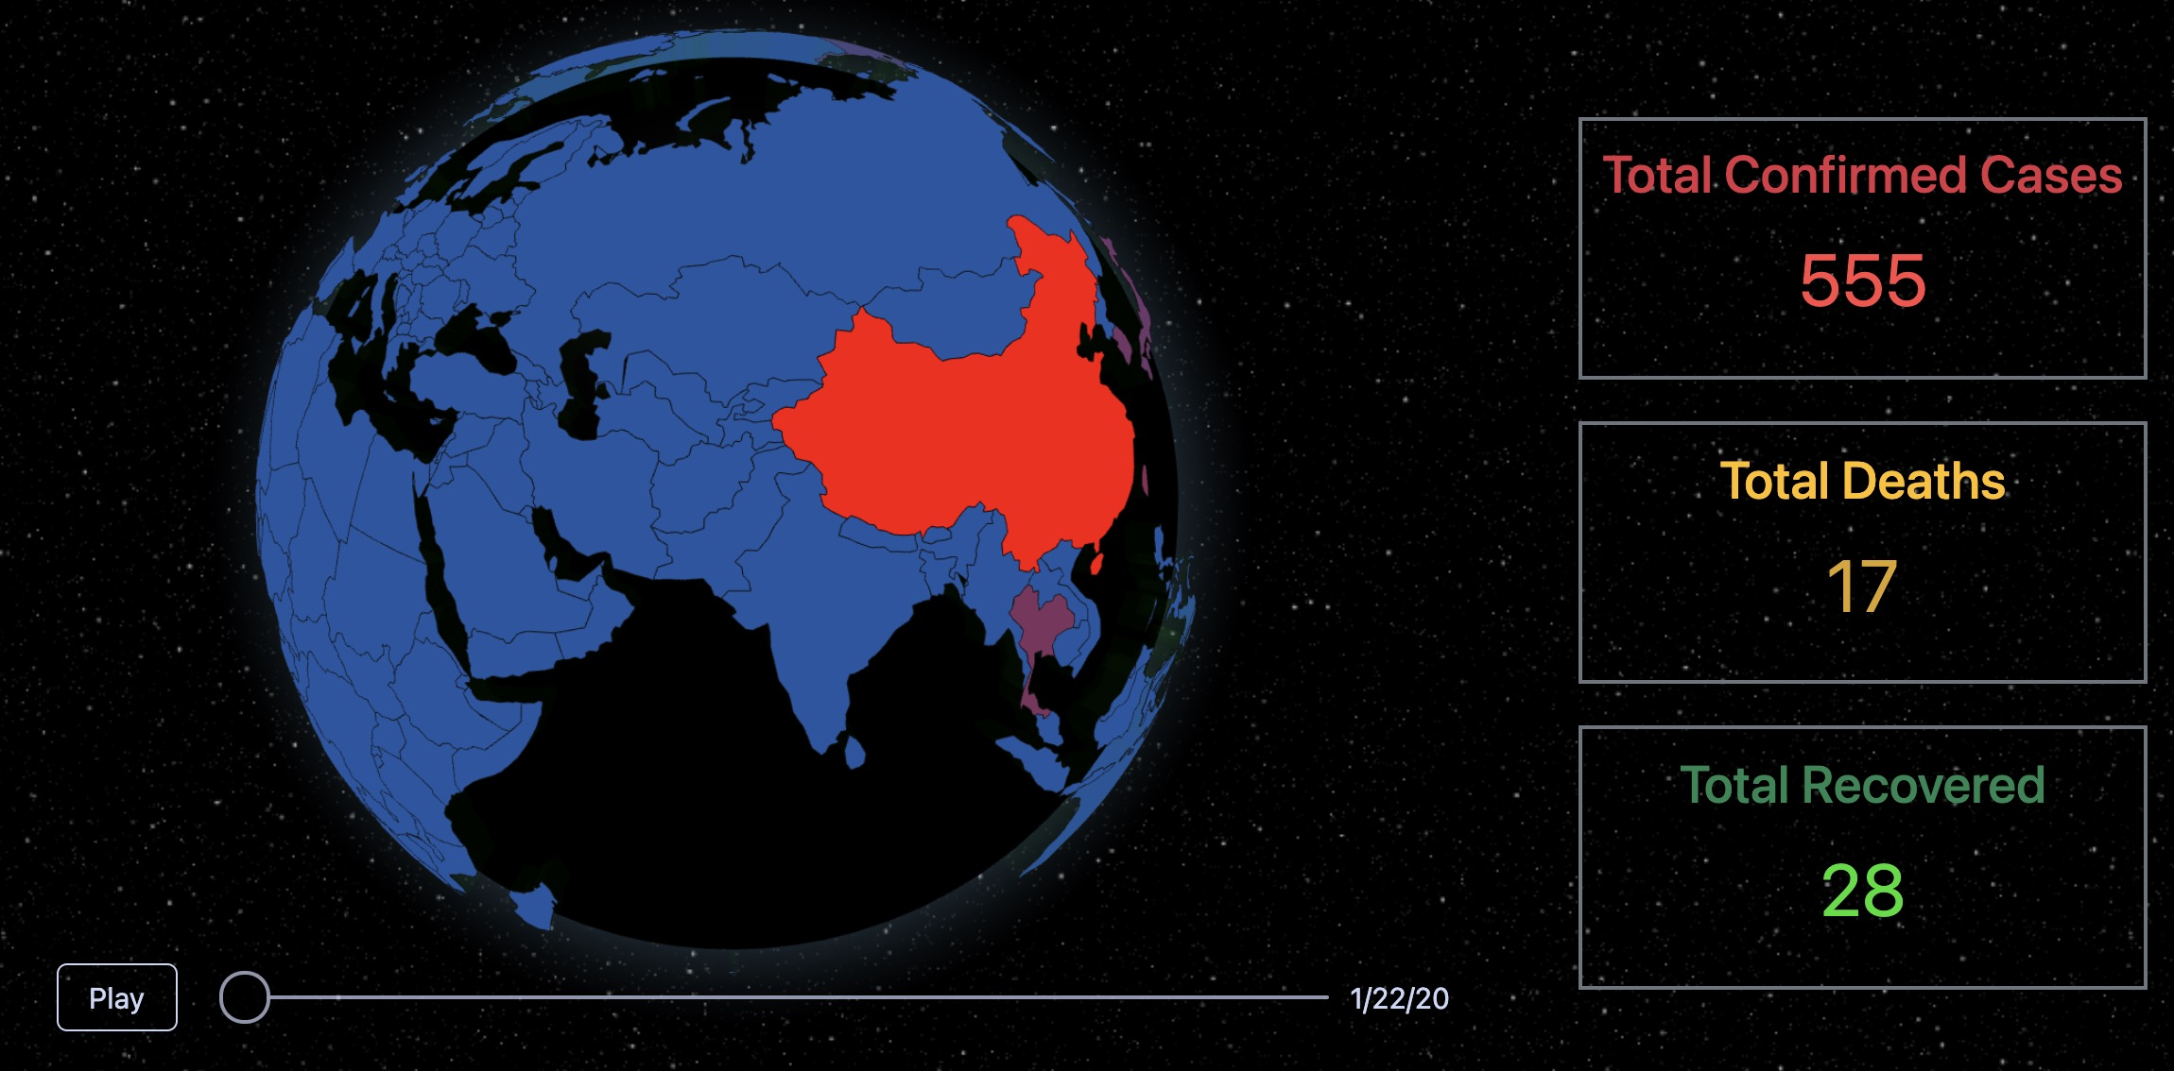
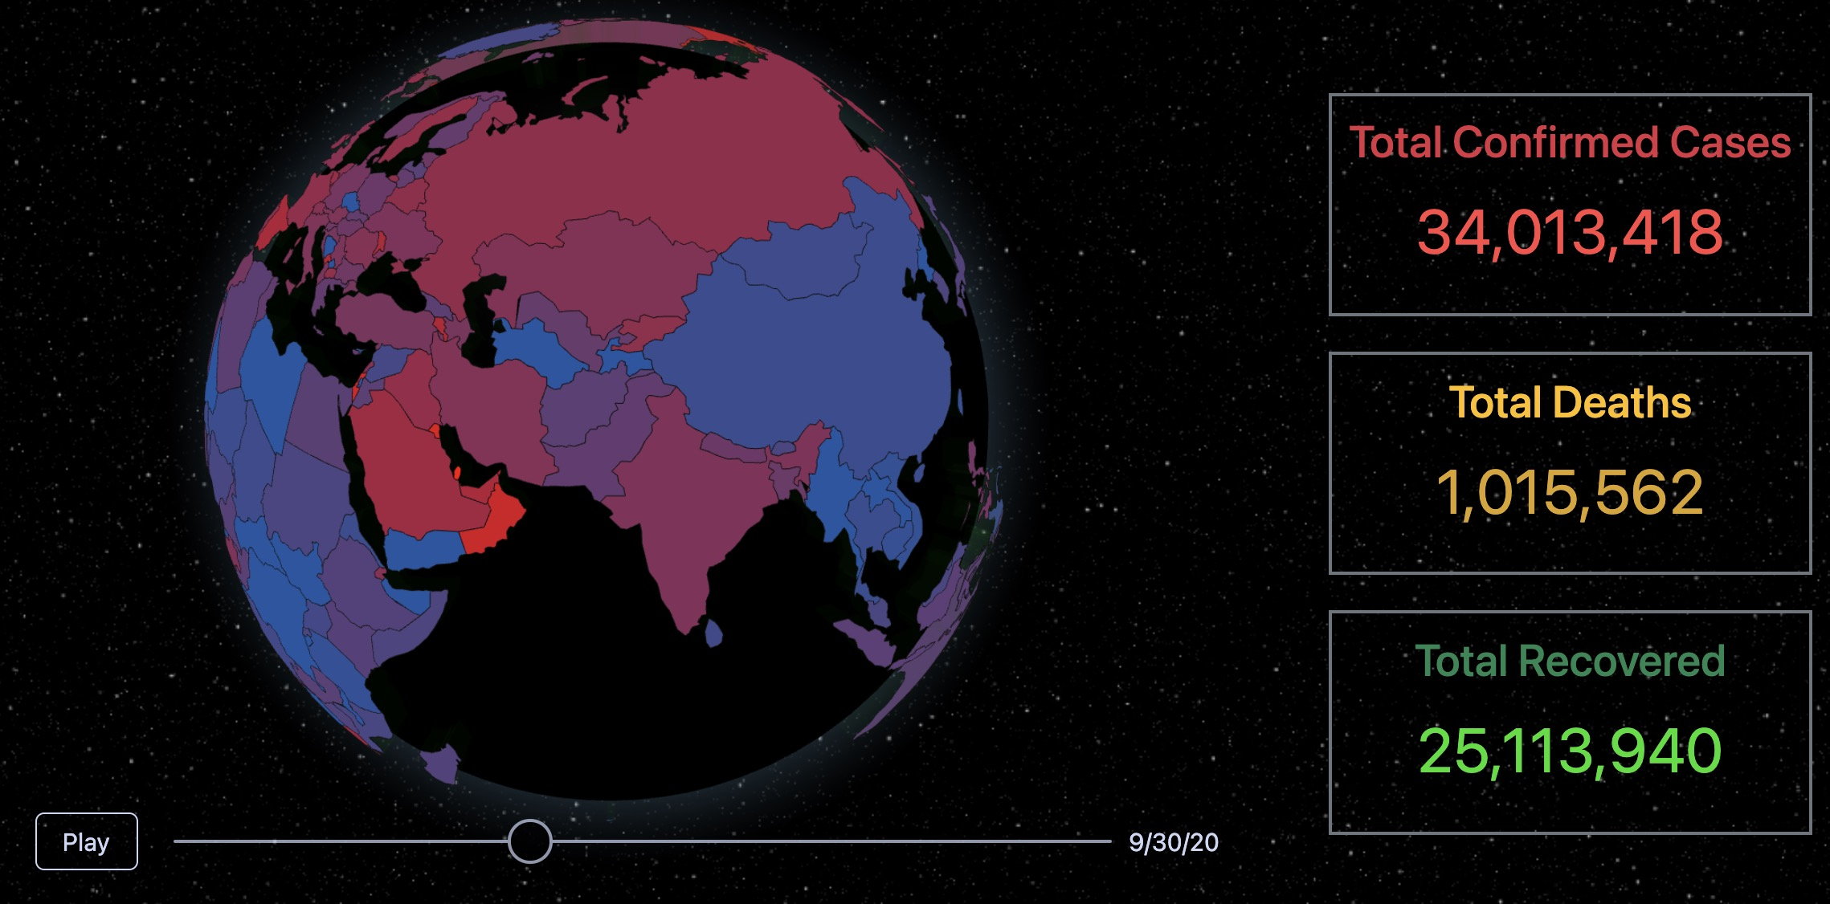
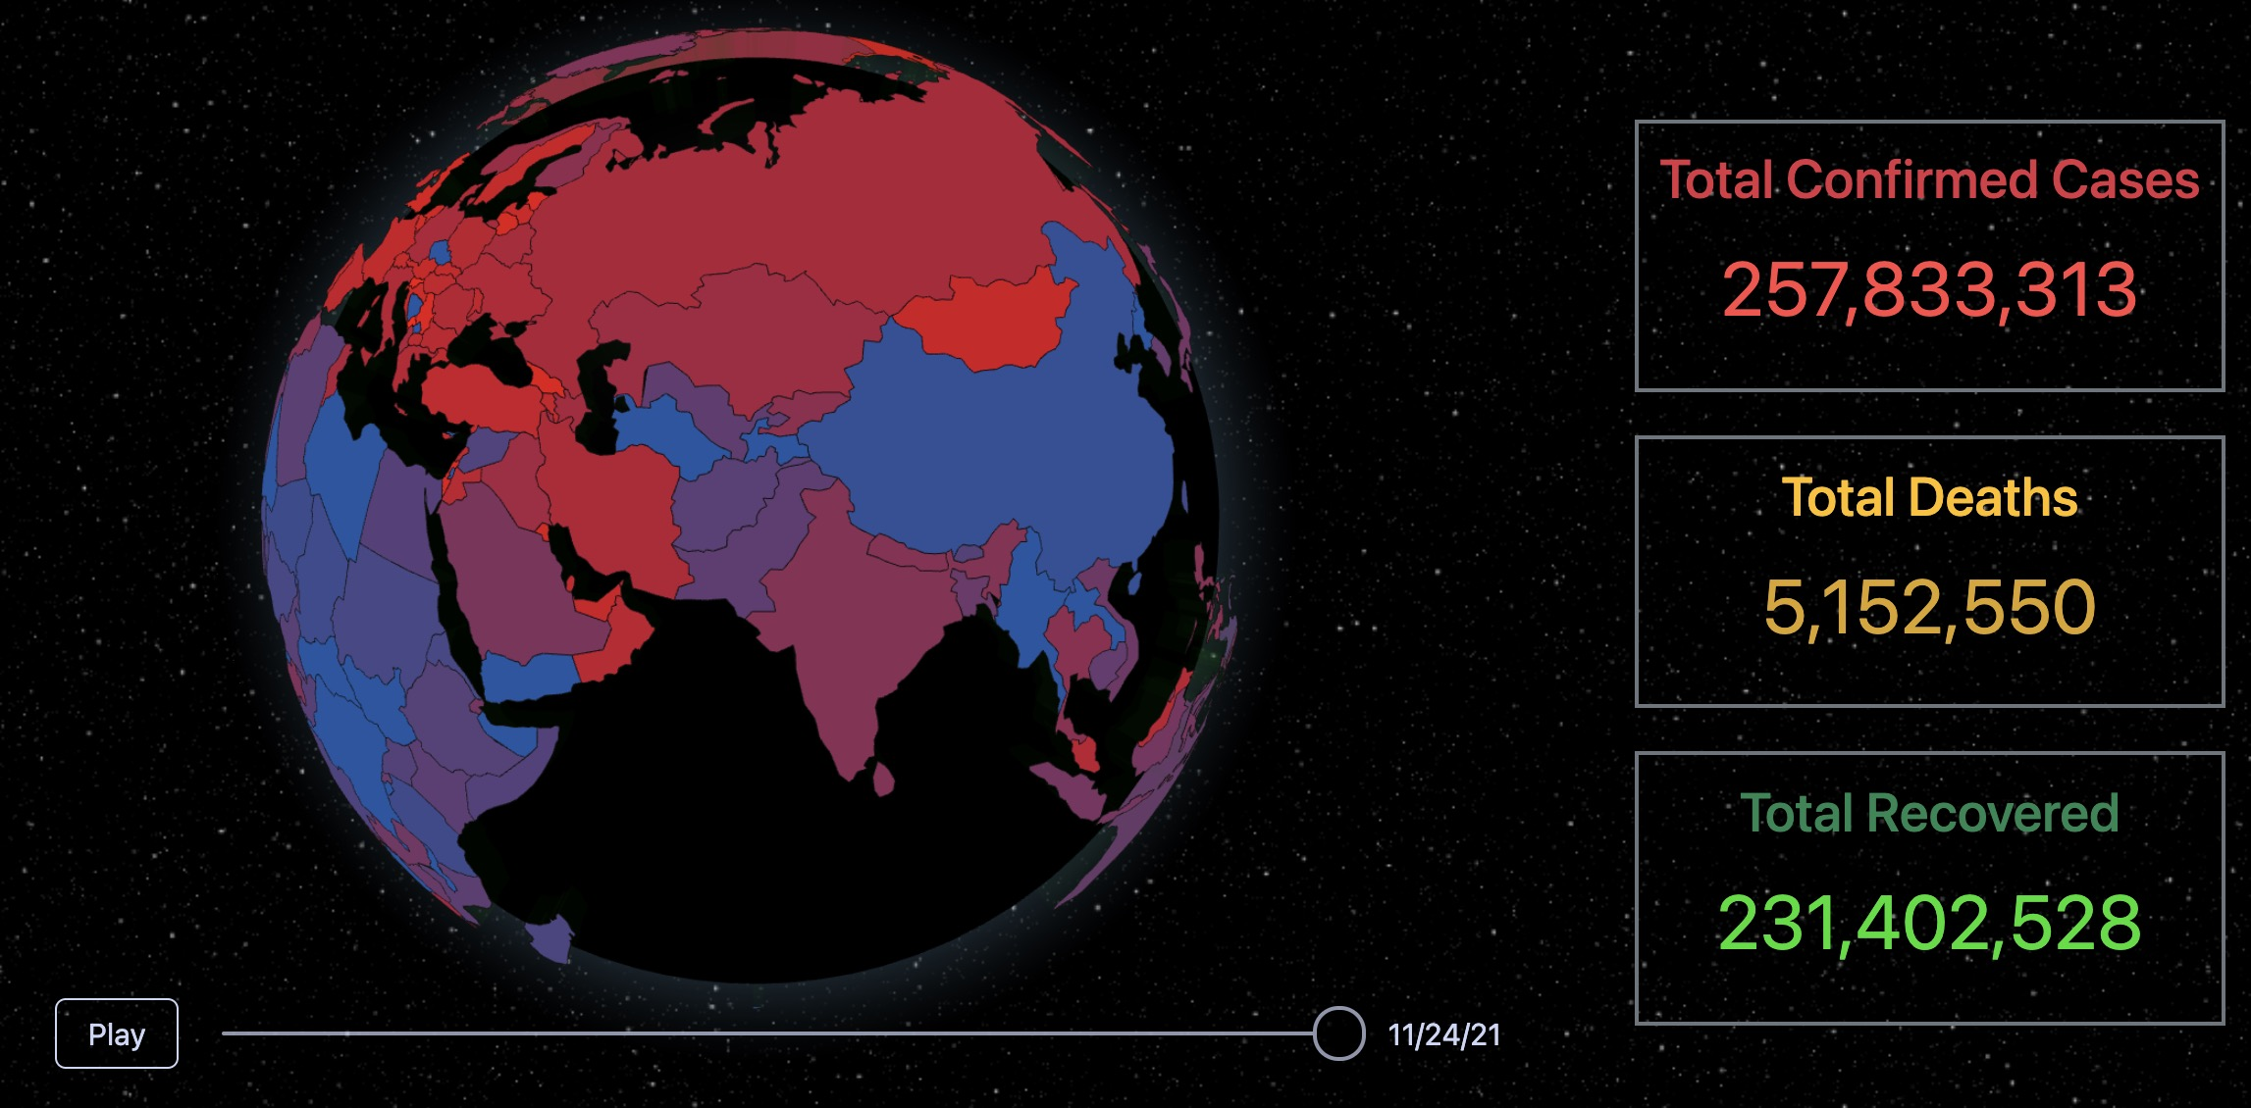
ShengYun Peng JunYan Mao GuanChen Meng ZeFang Liu YuXuan Wang HuiLi Huang
COVID-19 GLOBAL VISUALIZATION
INTRODUCTION AND MOTIVATION
DATASETS
Twitter, as a leading social platform, generates over 800 million Tweets in a single day. Tweets on COVID-19 are too overwhelming for users to extract useful information. Also, current COVID-related websites mainly provide 2-D COVID-19 visualizations. Main contributions and novelties:
Demonstrate how COVID-19 spread across the world
Manifest the correlation between trend in tweets and COVID-19 daily cases
Present a word cloud of most frequently occurring tokenized words
By performing the above visualizations, the project goal wishes to:
Evaluate the relationship between the COVID-19 cases and number of tweets in each country
Provide data visualization to assist users make decisions regarding pandemic
Give users an overview of the most popular topics about COVID-19 on Twitter
- Dataset-1: COVID-19 daily cases
Center for Systems Science and Engineering (CSSE) at Johns Hopkins University, which has COVID-19 cases by day, month and year
- Dataset-2: COVID-19 Twitter chatter dataset
Panacea Lab at GSU
Consists of COVID-19-related tweets acquired from the Twitter Stream
Provides top 1000 frequent terms, bigrams, and trigrams. Data used is March 1 to April 15, 2021 (to capture the second spike of COVID-19 cases in the U.S.)
GLOBAL COVID-19 VISUALIZATION
COVID-19 TWEET VISUALIZATION
COVID-19 TWITTER WORD CLOUDS
Approaches:
Select 6000 tweets with geographic coordinates from 408312 COVID-19 related tweets in March and April 2021
Use world globe for visualizing tweet locations effectively
Display higher and redder bars for more tweets in one position
Visualize twitter data by geographic coordinates, which innovatively present tweets number among countries
Experiments and results:
Evaluate legibility of the geographic data, density of coordinates, and distinctiveness of colors
Display two bar charts for the most common tweet countries and languages
World globe with proper longitude and latitude data giving the clearest result
Method:
Words are selected from frequently discussed topics on Twitter
Word sizes are positively correlated to the number of counts
Non-English words are filtered out by the langdect library
Words with repetitive meanings are manually filtered out. E.g., “covid19”, “covid-19”, and “coronavirus19”
Dates and numbers are filtered out. E.g., “million”, “000”, “19”
User interface of the global COVID-19 cases:
line charts
total number
country-wise cases of the selected date
the navigation bar
Dragging along the slide bar displays daily COVID-19 case data, and each country switches to corresponding color scheme. Meanwhile, the total cases are dynamically displayed on the right.
COVID-19 second wave
Word cloud animation
Experiments and findings:
Generate word cloud of the COVID-19 second wave.
Generate animated word cloud to show the most popular COVID-19 topic in each month from Jan-Apr 2021.
Prove the change of Twitter topics is related to COVID-19 situation.
Reflect the correlation between the epidemic and Twitter data
Find people’s changing ways of coping COVID-19 pandemic, from “hard immunity” to “vaccination”, from “social distance” to “boost shot”
Find the meaning of locations appeared in the word cloud, usually the most infected area by COVID-19
CONCLUSION
The 3-D global COVID-19 visualizer provides accurate and necessary information for all users. Interactive functions display the evolution of the pandemic.
The number of COVID-19 tweets from one location has a positive relation with its number of COVID-19 cases.

